Slide 1



Result Seminar
INTEGRATING PROGRESSIVE LEARNING AND SERIOUS GAMES IN GAMIFICATION FOR BALANCED EDUCATIONAL EXPERIENCES
TASI-2425-110
Supervisor : Parmonangan R. Togatorop S.Kom.,M.T.I
Examiner I : Samuel I. G. Situmeang, S.Ti., M.Sc
Examiner II : Sarah Rosdiana Tambunan, S.Kom.,M.Cs.
TASI-2425-110
Information System Study Program
Faculty of Informatics and Electrical Engineering, Institut Teknologi Del 2024/2025

Slide 2



TASI-2425-110
12S21002
12S21009
12S21056
Marudut B Tampubolon
Mikhael Janugrah Pakpahan
Endang Siregar

Slide 3

OUTLINE
Background
2. Research Question
3. Research Purpose
4. Literature
5. Scope
6. Research Method
7. Analysis
8. Design
9. Implementation
10. Result and Disscussion

Slide 4


BACKGROUND

Slide 5
Research Background
Gamification applies game elements (points, badges, levels) into education to increase motivation and engagement. Platforms like Duolingo and Quizizz show its success.
However, many students focus more on rewards than truly understanding the material. This reduces the effectiveness of learning.
Adaptive gamification and progressive learning offer a solution. They adjust difficulty levels based on the user's progress, helping learners stay motivated and challenged.
Serious games enhance learning by combining practice with theory and providing real-time feedback.

Slide 6
RESEARCH QUESTION

Slide 7
Research Question
What gamification elements can be effectively implemented in an educational web application to enhance user engagement without causing user dependency?
How can Progressive Learning and Serious Games (SGs) approaches be integrated into gamification design to create a more effective and sustainable learning experience?

Slide 8
RESEARCH PURPOSE

Slide 9
Research Purpose
To design an educational web application integrated with Gemini AI API using a balanced gamification approach to enhance user engagement without causing over-dependence on rewards.
To develop an integration strategy between Progressive Learning and Serious Games (SGs) to create a comprehensive, engaging, and deep learning experience.

Slide 10
LITERATURE

Slide 11
Gamification
Gamification applies game-like elements in non-game settings such as education to motivate, engage, and improve learning outcomes. The following elements are commonly used:
🧩 1 Points
Points are designed to motivate users by rewarding actions and progress instantly.
🧱 2 Levels / Ranks
Levels create a structured and dynamic learning journey, showing progress and achievement.
🏆 3 Leaderboards
A leaderboard is a visual tool that displays user rankings based on collected points, encouraging healthy competition.
⏱️ 4 Time
Time adds challenge and excitement, encouraging focus and faster decision-making in tasks.

Slide 12
Gamification
📊 5 Progress Bar
A progress bar provides a visual representation of user achievement, helping track and motivate continuous learning.
🎖️ 6 Badges
Badges are symbolic rewards that boost motivation, engagement, and a sense of accomplishment.
🎯 7 Challenges or Quests
Challenges give users goals and purpose, increasing interactivity and immersion in the learning process.
🎁 8 Rewards
Rewards encourage active participation, but must be balanced to prevent over-dependence.

Slide 13
Serious Games
📌 What are Serious Games?
Games designed for education, training, or skill-building, not just for entertainment.
📌 How are they used in this research?
Combine learning strategies, structured content, and game elements.
Aim to teach specific skills, knowledge, and attitudes.

Slide 14
Serious Games
📌 Key Features:
Use of real-time feedback to support learning.
Provide interactive and fun learning experiences.
Include rewards, challenges, and levels to keep users motivated.
📌 Benefits:
Improve understanding and focus.
Increase learning motivation and engagement.
Allow users to practice skills in a safe environment.

Slide 15
Progressive Learning
🔹 Definition & Core Concept
Progressive Learning in gamification is a step-by-step learning approach where content or skills are presented sequentially with increasing levels of difficulty.
🔹 How It Works
Learning starts from basic to advanced concepts
Uses levels, challenges, and rewards to track progress
Creates a structured, fun, and goal-driven experience
🔹 Personalization & Adaptivity
Challenges are tailored to each user’s ability
Keeps users in the optimal challenge zone
Supports personalized learning paths for better outcomes

Slide 16
SCOPE

Slide 17
Scope
This study focuses on:
Designing an educational website application integrated with Gemini AI, applying balanced gamification to enhance user engagement without causing dependency.
Implementing a progressive learning approach, which adjusts the difficulty level of questions based on user performance to support deep understanding.
Utilizing Serious Games (SGs) in the form of interactive quizzes to provide real-time feedback, reinforcing the connection between theory and practice.
Using user satisfaction surveys and achievement-based evaluations to measure the effectiveness of gamification in improving motivation and comprehension.

Slide 18
Scope
The scope limitations are as follows:
The study is limited to participants from Institut Teknologi Del (students and lecturers), thus the findings may not be generalized to other institutions.
The Serious Games (SGs) used are limited to quiz-based formats; other types such as simulations or complex games are not included.
The focus is solely on gamification in quiz-based learning contexts; other learning approaches are not explored in depth.
User engagement evaluation is limited to short-term methods (Likert-scale surveys, open-ended feedback, and performance tracking); long-term observation (longitudinal study) is not conducted.

Slide 19
RESEARCH METHODS

Slide 20
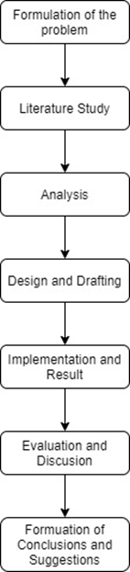
Research Methods
The following are the stages of the research that will be conducted:

Slide 21
ANALYSIS

Slide 22
Analysis of Gamification
Gamification in this study is chosen for its ability to boost motivation, engagement, and learning effectiveness through interactive game elements. It creates an enjoyable and challenging learning environment, personalizes learning by adjusting difficulty levels, and provides real-time feedback. By integrating elements like points, levels, leaderboards, time, and progress bars, gamification balances entertainment with learning, improving academic outcomes and overcoming challenges in traditional learning.

Slide 23
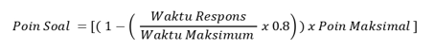
Analysis of Gamification
Point
Points in gamification boost motivation and engagement by rewarding achievements, such as completing tasks or answering quizzes correctly. They allow users to track progress, creating a sense of accomplishment and encouraging continued learning. Points provide measurable feedback and can be customized to match task difficulty, fostering fair effort reflection and enhancing competitiveness when combined with elements like leaderboards or levels.
The formula to calculate the points earned by a user is as follows:

Slide 24
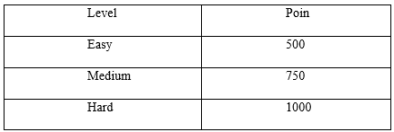
Analysis of Gamification
The steps to calculate the points are as follows:
Measure the Response Time and Maximum Time.
Calculate the proportion of Response Time to Maximum Time.
Multiply the proportion by 0.8.
Subtract the result from 1 to get the Point Factor.
Multiply by the Maximum Points.
The maximum points value is:

Slide 25
Analysis of Gamification
2. Level
The level element in gamification plays a crucial role in creating a clear, step-by-step learning structure. It helps students track their progress and provides a sense of achievement as they advance through levels. By breaking content into levels, students can focus on simpler tasks before moving to more complex ones, with gradually increasing challenges motivating skill development.
Levels boost motivation by offering rewards for advancement, providing a structured framework for learning. This makes learning enjoyable as students experience satisfaction upon reaching milestones. The progressive structure helps prevent overwhelm and builds a solid understanding.

Slide 26
Analysis of Gamification
2. Level
The level system, with easy, medium, and hard levels, adapts to students’ abilities. It starts with basic concepts and increases difficulty to higher-level understanding, supporting personalized learning. This system also allows instructors to monitor progress and provide timely interventions, enhancing both motivation and engagement for effective learning.

Slide 27
Analysis of Gamification
3. Progress Bar
The progress bar boosts student engagement by visually tracking progress in real-time. It shows how much of a task or goal has been completed, creating a sense of achievement and motivating students to keep going. By breaking the learning process into smaller steps, it helps users focus on one task at a time and provides clarity, boosting confidence.
Its strength lies in simple yet effective visual feedback that motivates students to meet targets and reduces overwhelm by showing goals can be achieved in stages. It also keeps users engaged and allows instructors to monitor progress easily, making it a key element in gamification for motivating and structured learning.

Slide 28
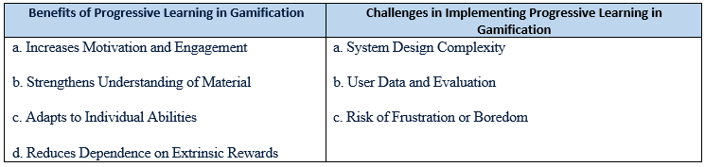
Analysis of Progressive Learning
This section discusses Progressive Learning in this research, which structures learning materials from simple to complex based on the learner’s abilities. In gamification, it enables adaptive elements like levels, challenges, and rewards to gradually enhance competencies without overwhelming learners, supporting a dynamic learning experience.
Benefits and Challenges of Progressive Learning in Gamification

Slide 29
Analysis of Serious Games
Serious games are games designed with purposes beyond entertainment, such as education, training, or skill development. In educational gamification, serious games integrate game elements to create engaging, interactive, and practical learning experiences. Features like simulations, challenges, and real-time feedback help learners apply concepts in real-world or realistic environments.

Slide 30
Analysis of Evaluation
Evaluation is conducted to measure how effectively the gamification system supports the learning process and enhances student motivation and engagement. In this study, the evaluation method used is: User Satisfaction Survey

Slide 31
Design

Slide 32
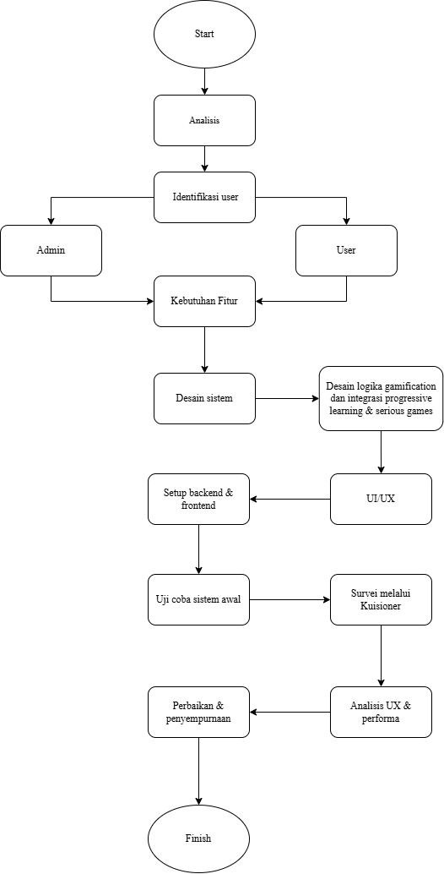
Research Design

Slide 33
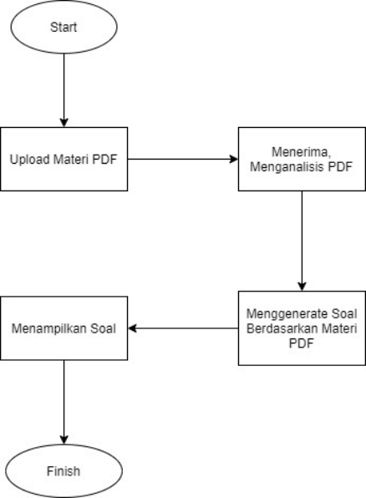
Generate Question Flow

Slide 34
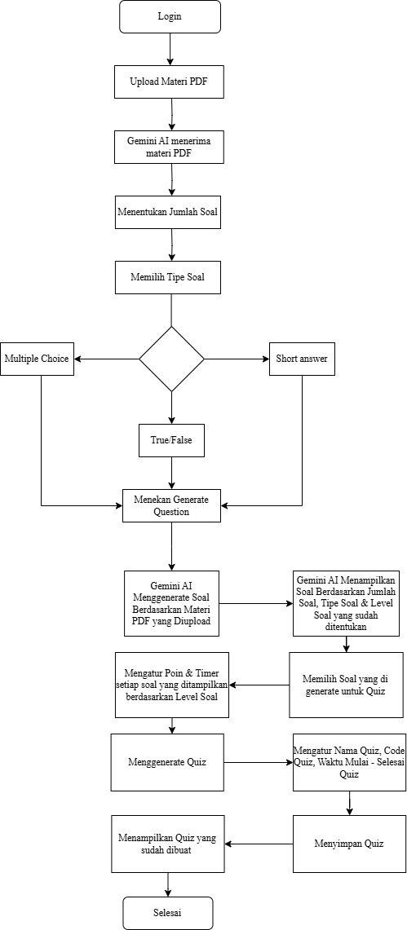
Application Design Admin (Dosen)

Slide 35
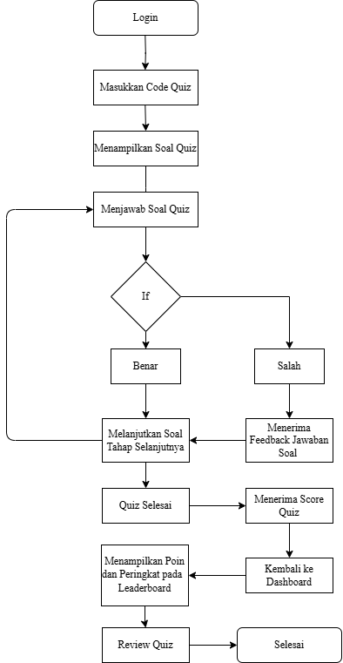
Application Design Pengguna (Mahasiswa)

Slide 36
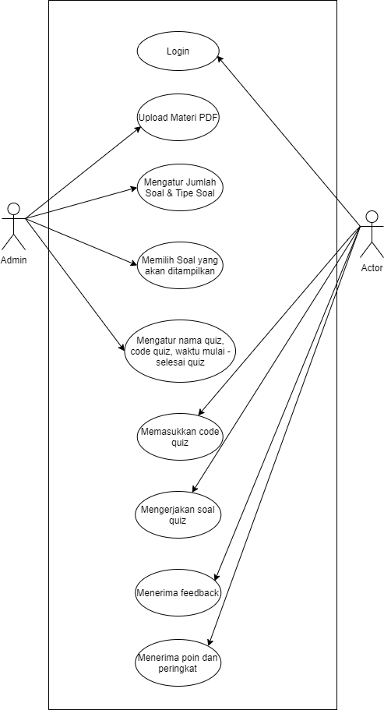
Usecase Diagram
This use case diagram illustrates the interaction between two main actors: the Admin and the Actor (user/student) within a quiz-based learning system.
Both the Admin and the Actor begin by logging into the system. The Admin is responsible for uploading learning materials in PDF format, setting the number and types of questions, selecting which questions will be displayed, and configuring the quiz details such as its name, access code, and start-end time.
Once the quiz is set up, the Actor enters the provided quiz code to access the quiz, then proceeds to answer the questions. After completing the quiz, the system provides feedback and displays the points and ranking based on the Actor’s performance.

Slide 37
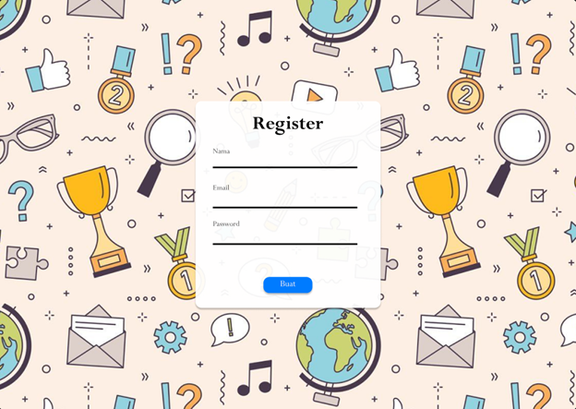
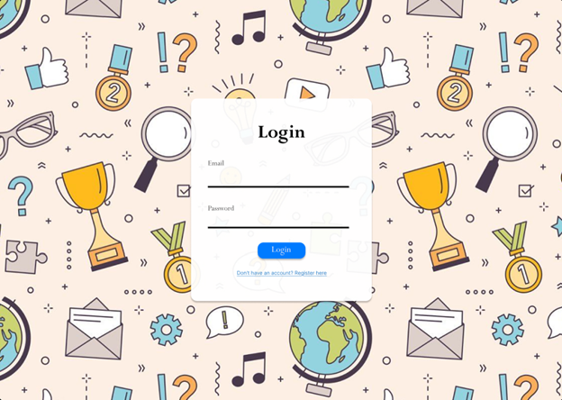
Mockup Design for Student
This section provides an explanation of the learning application for student, as shown in the following image.
The user account registration screen is for registering a new account for users who may not have access to the system yet. Students will register with their email and password to access the system. The login page is the initial view of the application, intended for users to sign into their accounts.

Slide 38
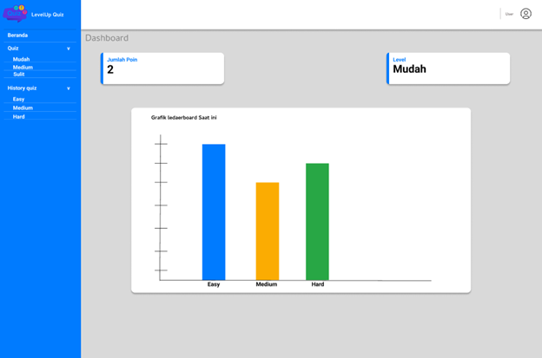
Mockup Design for Student
This section provides an explanation of the learning application for student, as shown in the following image.
Dashboard for Student

Slide 39
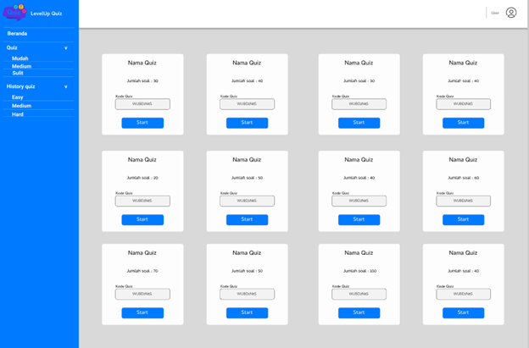
Mockup Design for Student
This section provides an explanation of the learning application for student, as shown in the following image.
List of Quiz Screen

Slide 40
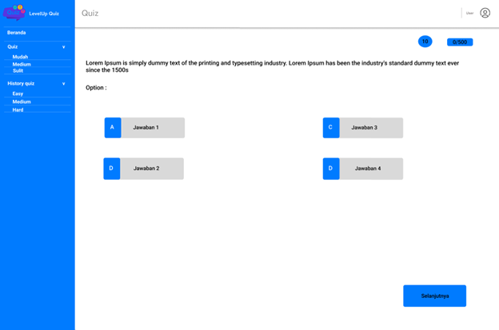
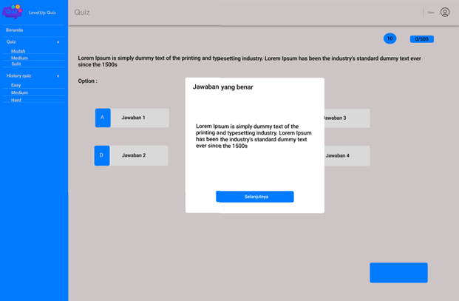
Mockup Design for Student
This section provides an explanation of the learning application for student, as shown in the following image.
Multiple Choice Quiz Screen
Student Quiz Feedback Screen

Slide 41
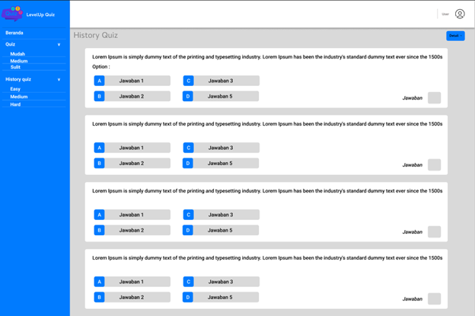
Mockup Design for Student
This section provides an explanation of the learning application for student, as shown in the following image.
User Quiz History Screen

Slide 42
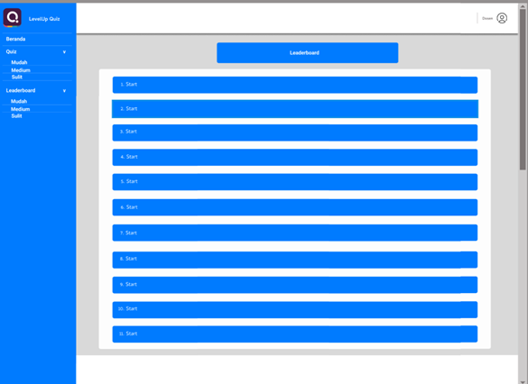
Mockup Design for Student
Leaderboard Screen

Slide 43
Mockup Design for Admin
This section provides an explanation of the learning application for administrators (Lecturers), as shown in the following image.
The login page is the initial screen of the application, designed for admins to log into their accounts. Once logged in, admins can begin managing the learning process.

Slide 44
Mockup Design for Admin
DASHBOARD
The Dashboard provides an overview of ongoing quiz activities for the instructor. It displays quiz statistics, such as the number of completed or ongoing quizzes, and allows the instructor to manage quizzes, including creating, editing, or deleting them based on difficulty levels. The instructor can also monitor user performance through the leaderboard, both overall and by quiz difficulty, and use the leaderboard chart for visual analysis of user progress.

Slide 45
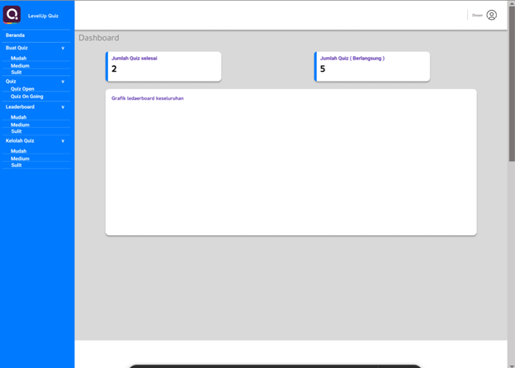
Mockup Design for Admin
DASHBOARD

Slide 46
Mockup Design for Admin
DASHBOARD
The main dashboard displays the navigation menu as follows:
Home
Create Quiz
Quiz
Leaderboard
Manage Quiz
The main section of the dashboard includes:
Number of Completed Quizze
Number of Ongoing Quizzes
Overall Leaderboard Chart

Slide 47
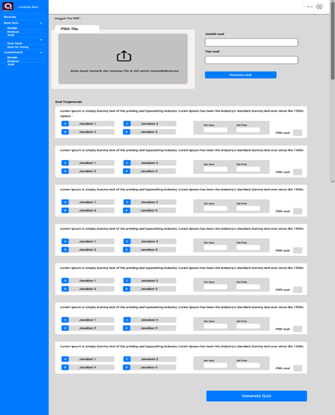
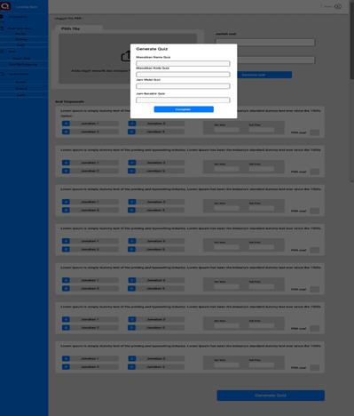
Generated Question Screen
Generate Quiz Pop-up Screen

Slide 48
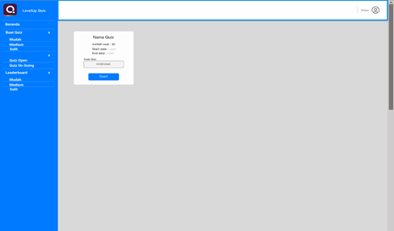
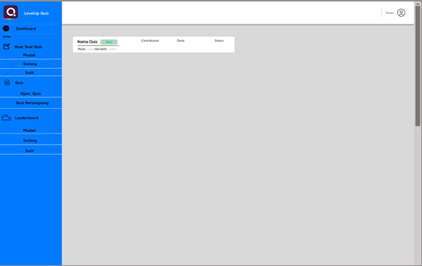
Quiz List Screen
Quiz Status Screen

Slide 49
IMPLEMENTATION

Slide 50

Demo Video

Slide 51
RESULT
&
DISCUSSION

Slide 52
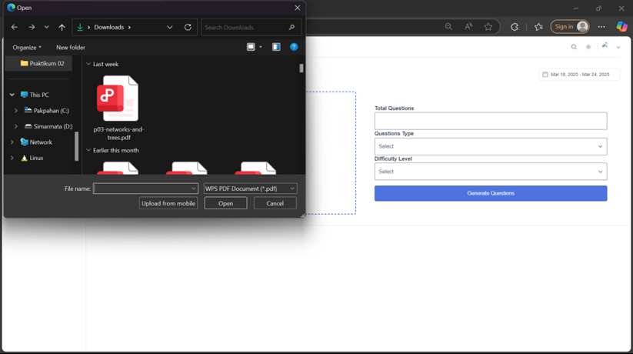
Result View Upload Material PDF

Slide 53
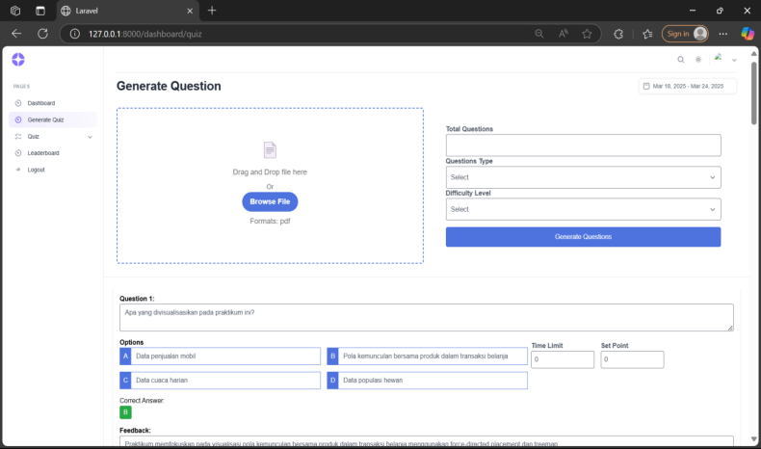
Result View generate question Multiple choice

Slide 54
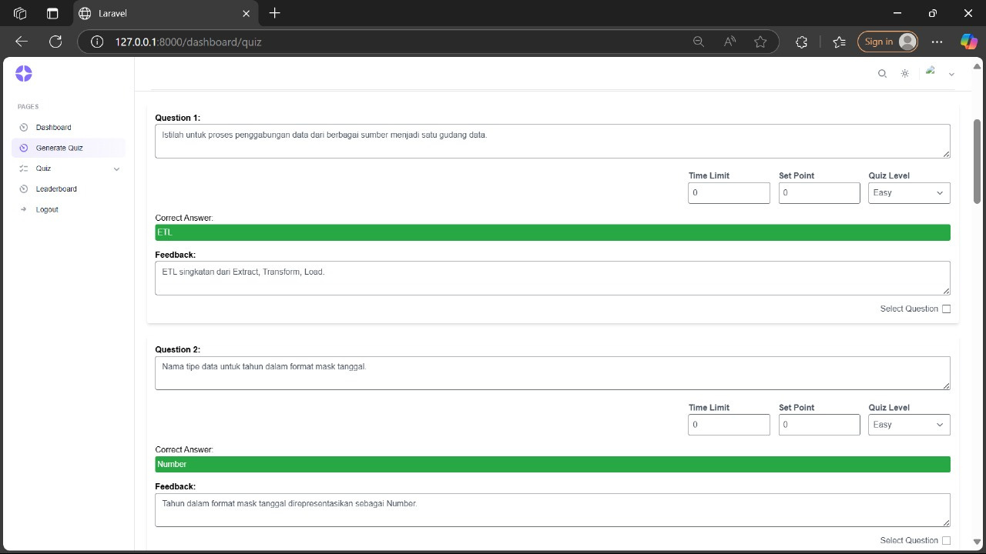
Result View generate question short answer

Slide 55
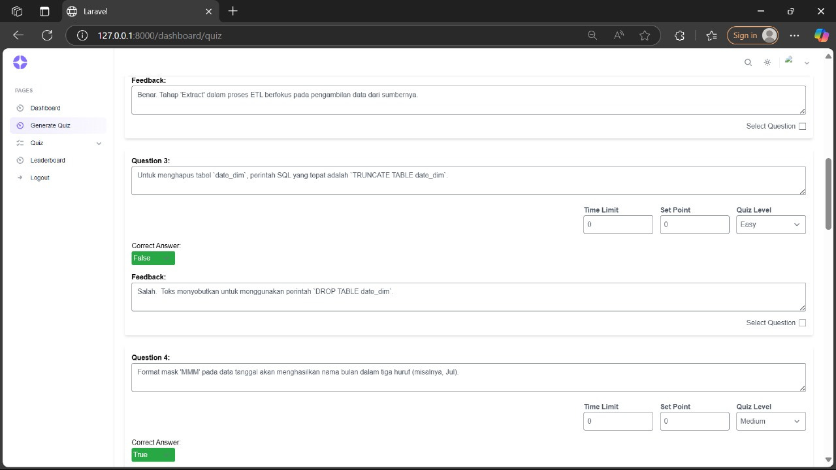
Result View generate question short answer

Slide 56
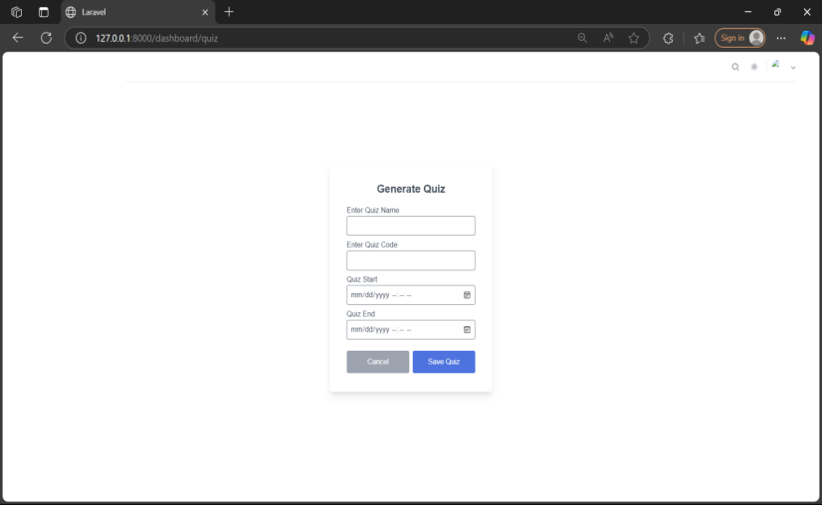
Result View generate quiz

Slide 57
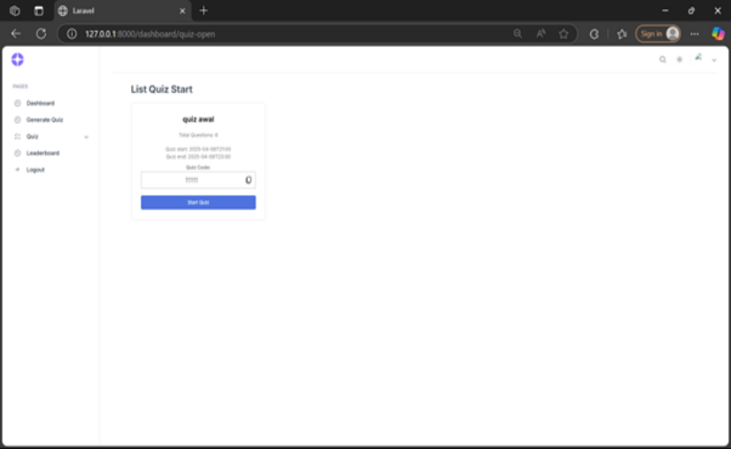
Result View open quiz

Slide 58
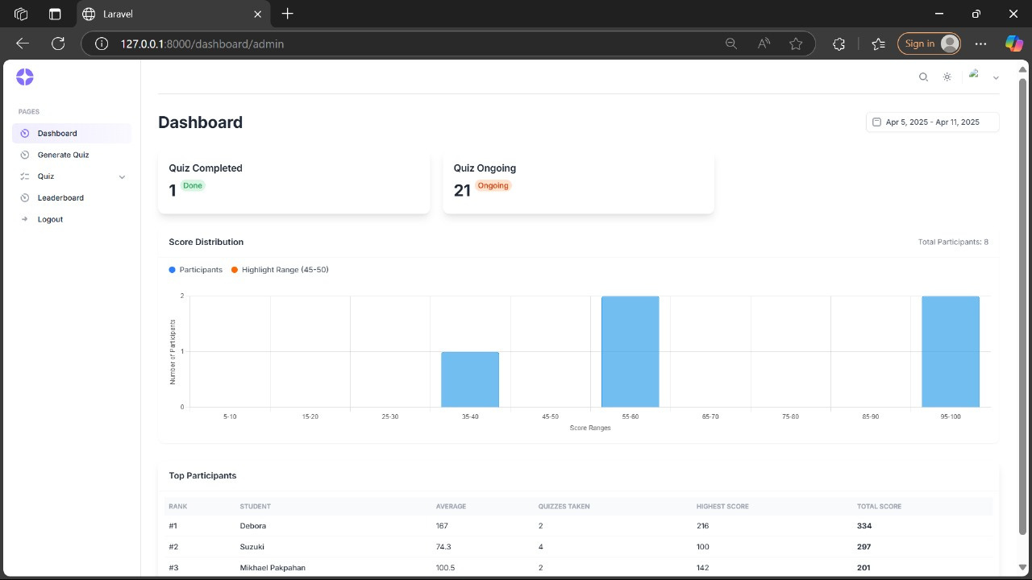
Result View Dashboard Admin

Slide 59
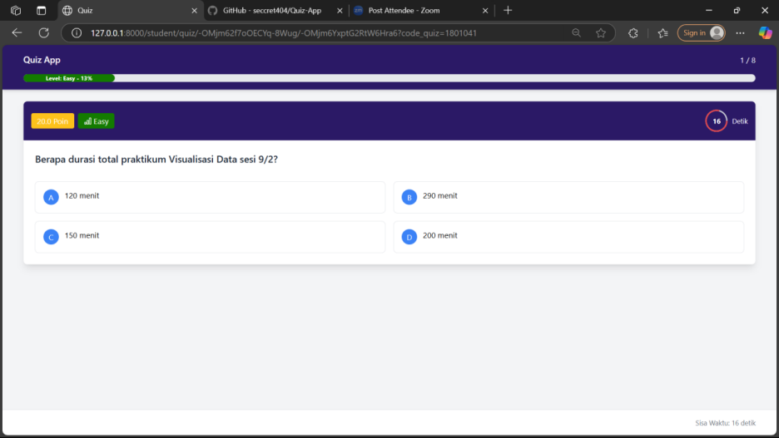
Result View multiple choice question

Slide 60
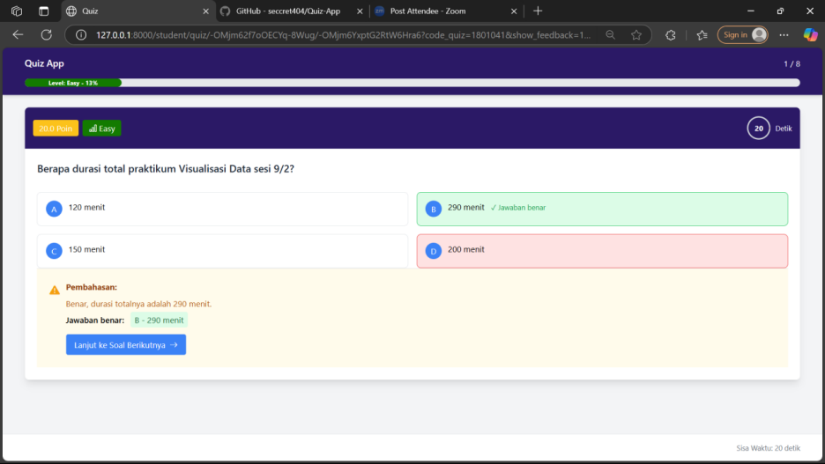
Result View multiple choice feedback

Slide 61
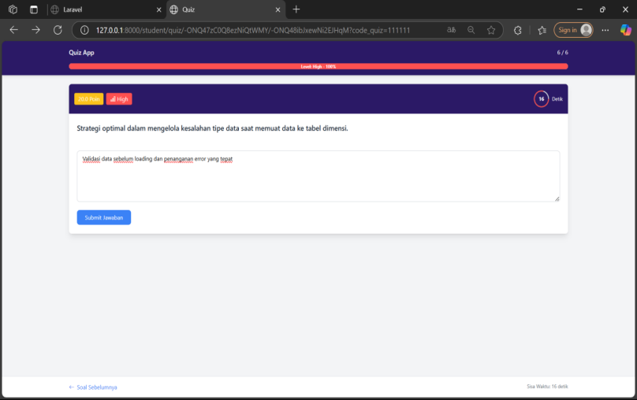
Result View essai question

Slide 62
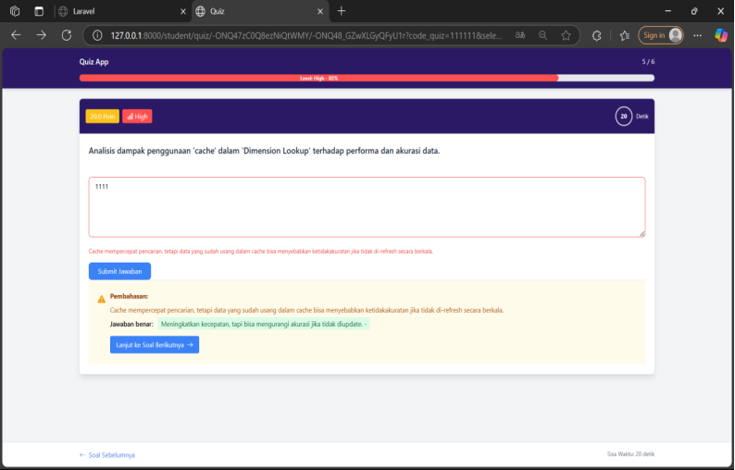
Result View feedback essai question

Slide 63
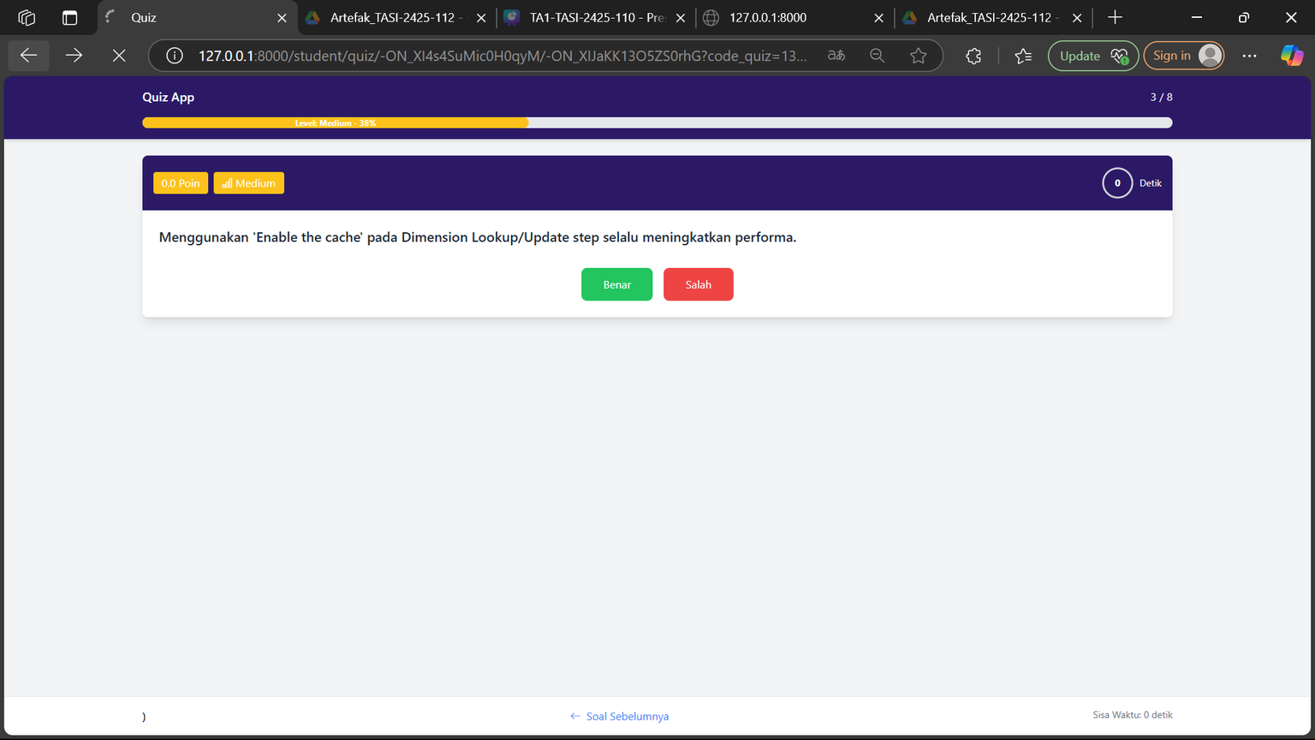
Result View true or false question

Slide 64
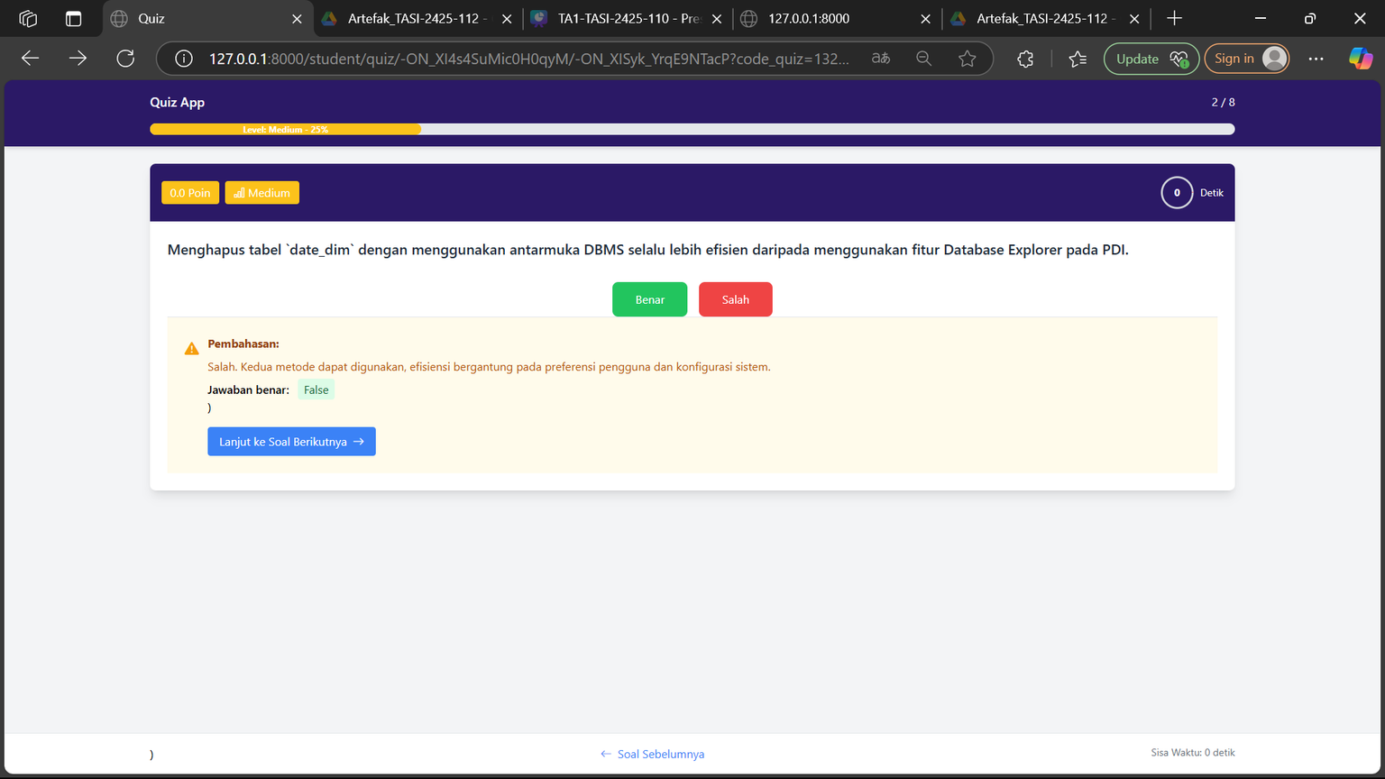
Result View feedback true - false question

Slide 65
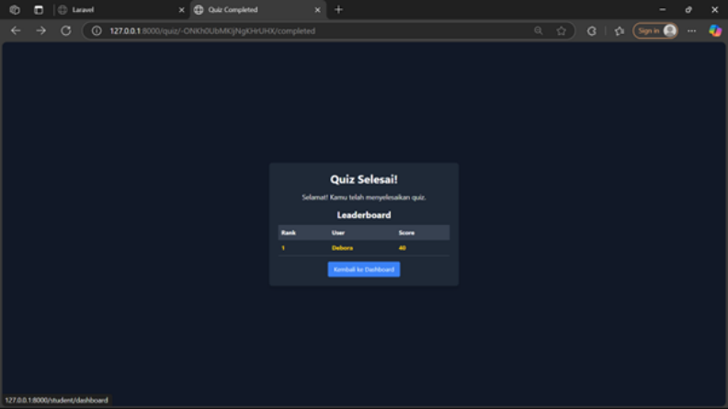
Result View Leaderboard

Slide 66
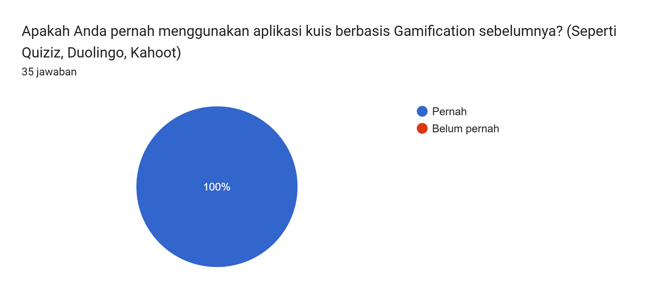
Evaluation

Slide 67
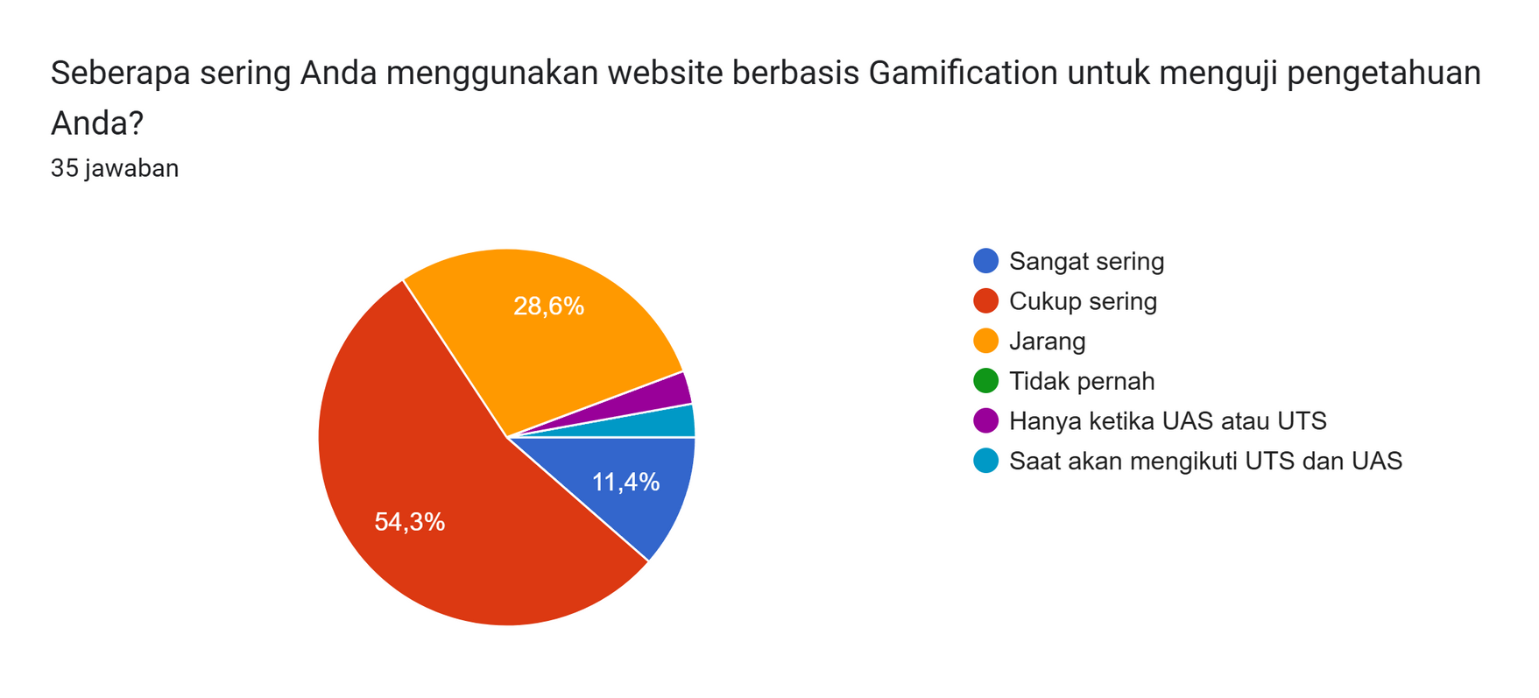
Evaluation

Slide 68
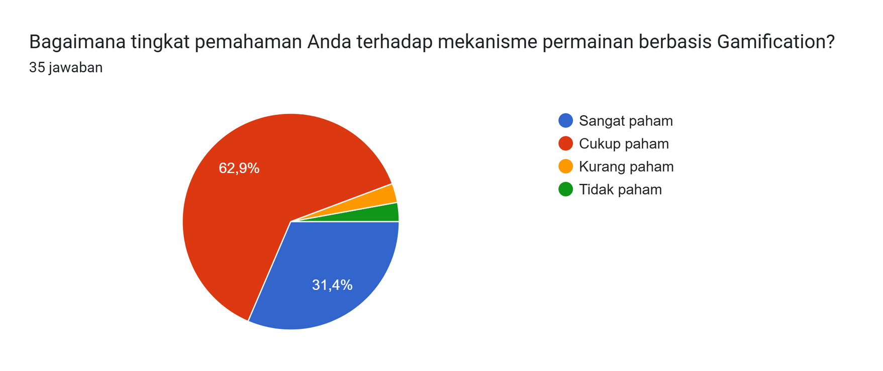
Evaluation

Slide 69
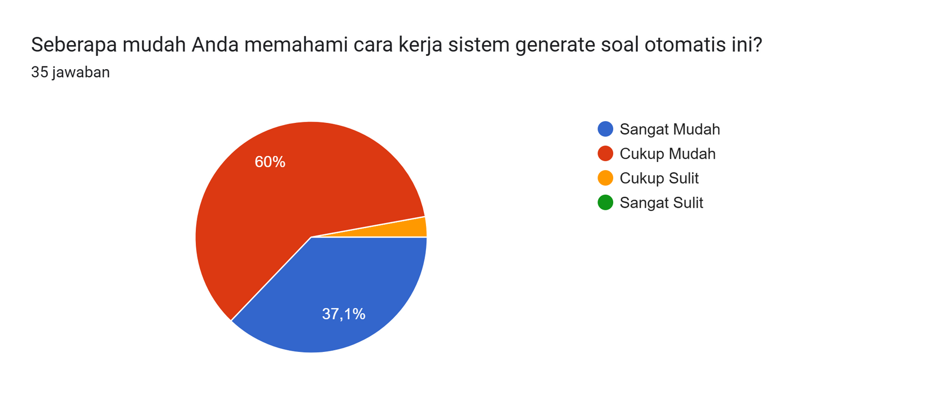
Evaluation

Slide 70
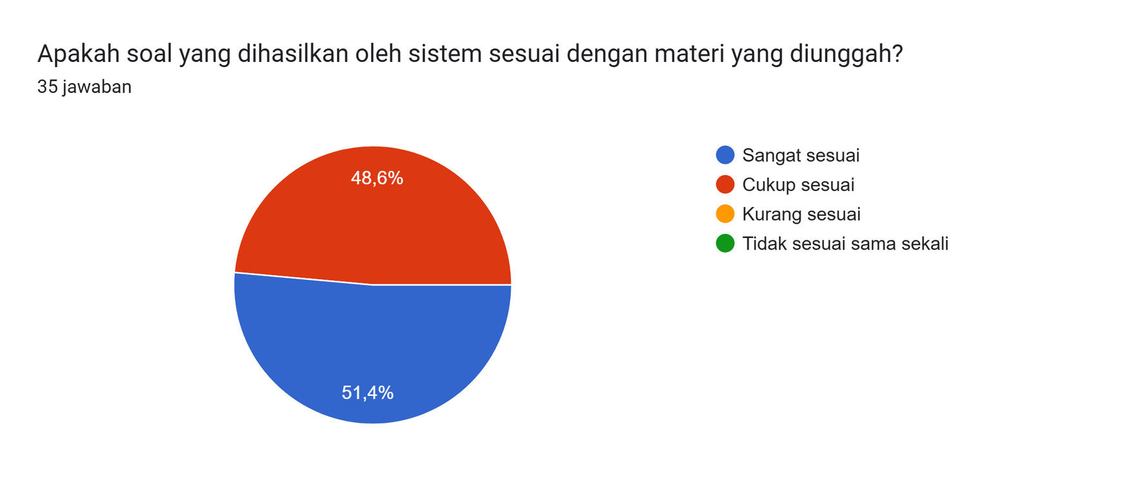
Evaluation

Slide 71
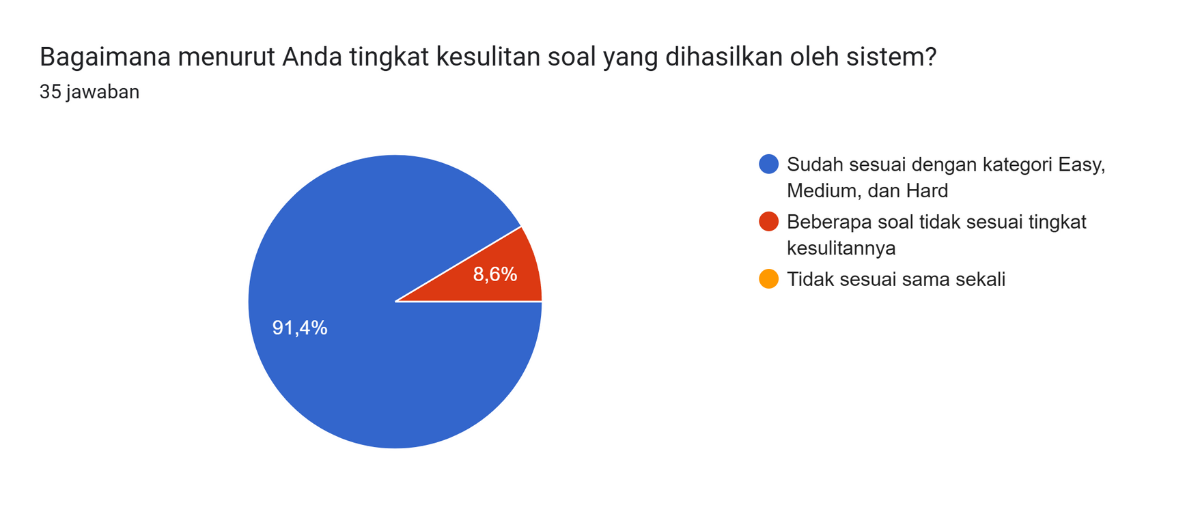
Evaluation

Slide 72
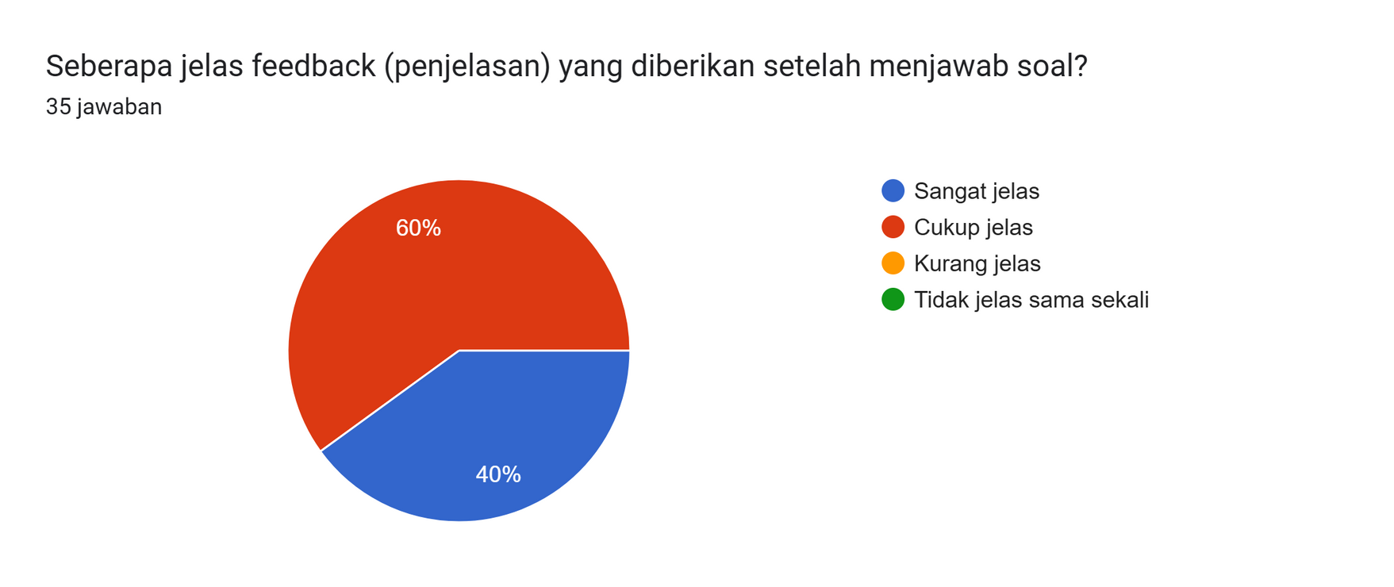
Evaluation

Slide 73
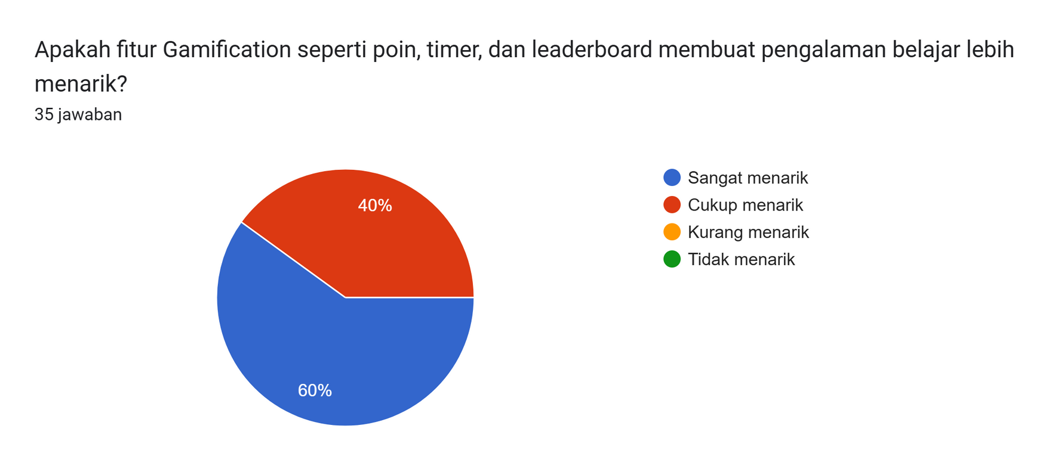
Evaluation

Slide 74

Evaluation

Slide 75
Thankyou!

